Slide 1
Peanut Butter scenario India and around the world
Prepared by - Vishal Ruparel, Managing Director Ruparel Foods Private Limited

Slide 2
Established in 2007 we are the largest manufacturers and exporters of Peanut Butter from India and Winners of Award for Highest Exports of Peanut Butter awarded by IOPEPC Since 2011.
Our Peanut Butter manufacturing facility is a state of art facility certificate for IFS, BRC and HACCP.

Slide 3
Some known and unknown facts about peanut butter
Making Peanut Butter takes a lot of Peanuts: It takes approx. 540 Bold Peanuts of 40/50 to make 12oz that is 340g of Peanut Butter. So that means if just Americans eat 360 Million MT of Peanut Butter each year which is almost 500 Billion Peanuts!
What is Peanut Butter?: As per USDA (United States Department of Agriculture), in order to be called “Peanut Butter”, a product must contain at last 90% Peanuts. Other ingredients often includes Sugar, Oils, Salt and Stabilisers to prevent oil separation.

Slide 4
Current scenario and trends of manufacturing and sales of peanut butter in Domestic market: Part-I
Due to recent changes in climatic conditions in India which leads to too much or too less Rain and sometimes timeless and untimely Rain has impact on yield of Peanuts while manufacturing Peanut Butter.
Peanut Butter Manufacturers in India normally were using 40/50 counts of Bold Peanuts, but since last couple of years the Bold variety of Peanuts are with too much of Aflatoxin which has forced us to divert our interest in varieties that are having less or no Aflatoxin like TJ variety but simultaneously the yield has also decreased. Mainly because in TJ vareity 40/50 is almost very scarcely available or even though it is available the manufacturers cannot afford and then we have to rely on 50/60 and sometimes even 60/70 counts.
When we use 50/60 or even 60/70 we get very less yield of peanuts used for grinding into Peanut Butter which leads to lower output and indirectly high raw-material cost.
New Major Brands of FMCG Food Products have arrived in the market from Major Food Manufacturer Giants like, Amul, Kissan from HUL (Hindustan Uni-Lever), Sun Fest a new Economical brand introduced by Agrotech Foods the company that used to make Sundrop Peanut Butter, FunFoods a product by German Food Manufacturing Giant Dr. Oetker, India (which is one of the oldest brand of Peanut Butter in India). Along with these all Giants there are almost 50 local and small brands present in Indian market but most of them are on Online sales platform like Amazon and Flipkart.

Slide 5
Current scenario and trends of manufacturing and sales of peanut butter in domestic market: Part-II
Upto the end of F.Y. 2020-2021 the domestic market of Peanut Butter in India has seen a market increment of at least 50% year on year since 2018.
However the 2nd wave of COVID-19 that hit India by end of March upto June, 2021 has a very large and long-lasting effect on major retail sector which has its effect on sales of Peanut Butter as well. We have seen and have a lasting effect of decrease in sales by almost 50% since the 2nd wave of COVID-19 and still shows no recovery in coming months or even in these festive season the sales was almost too cold.
The major reason for this decrease in sales is due to shortages of financial and cash liquidity in the market and thus a resistance to accept the high inflation prices in the market.
Peanut Butter had picked up a new market which was food service and Peanut Butter used as an ingredient in making different foods like confectionary and bakery but after 2nd Wave of COVID-19 in India this market is almost at hold or not showing any recovery.

Slide 6
Current scenario and trends of manufacturing and sales of peanut butter in international market:
There was a very high demand of Peanut Butter in the international Market since the Pandemic Started in Early 2020 because when people were under lockdown and no restaurants where open people were more dependent on health foods like nuts spread and the most popular one was Peanut Butter which has high protein content and the cheapest among other nut spreads.
But since March 2021, when the Ocean Freights started increasing, this has hit our industry as well. The manufacturers have and are still taking a toll on their costs which is really making a bad impact on our cash flow and liquidity because where we were paying from freights to Europe as US$1500 for a 40’ HC container we are today paying US$7000 to US$7500 per container which is almost 4.5 to 5 times the cost and if a company has a yearly contract the retailer, then they are too adamant to take the share of the cost which obviously comes on the manufacturer.
In the coming months if this problem of Freight continues then this will definitely have an impact on the sales of Peanut Butter because the retailers have already started decreasing the forecast of buying for next year by almost 30% since the additional cost is not absorbable in the prevalent market.
The market of Bulk packed Peanut Butter and Peanut Paste has also taken a toll due to the ongoing Pandemic COVID-19 because the largest buying for Peanut Butter was mainly for RUTF (Ready to Eat Therapeutic Food) which is bought mainly by WHO, but since the Pandemic started and the Vaccine are out WHO has diverted its major Funds on buying and supplying of Vaccines for under privilege countries of Africa and South East Asia.

Slide 7
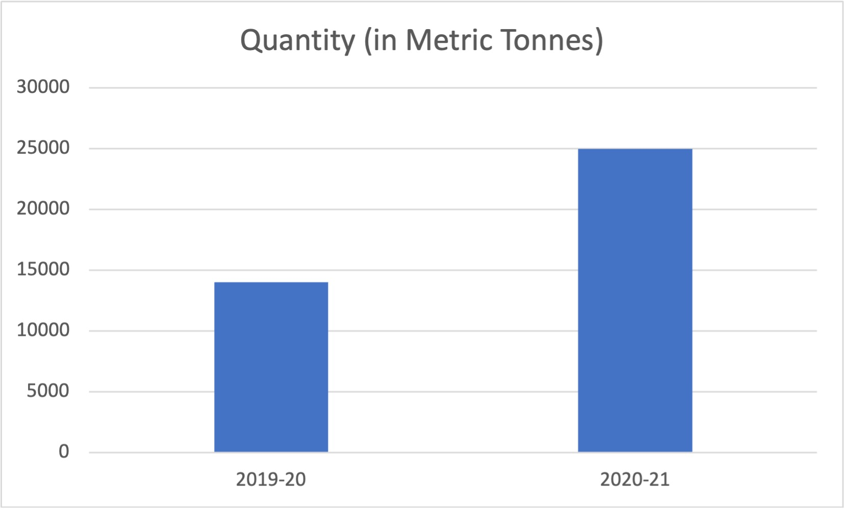
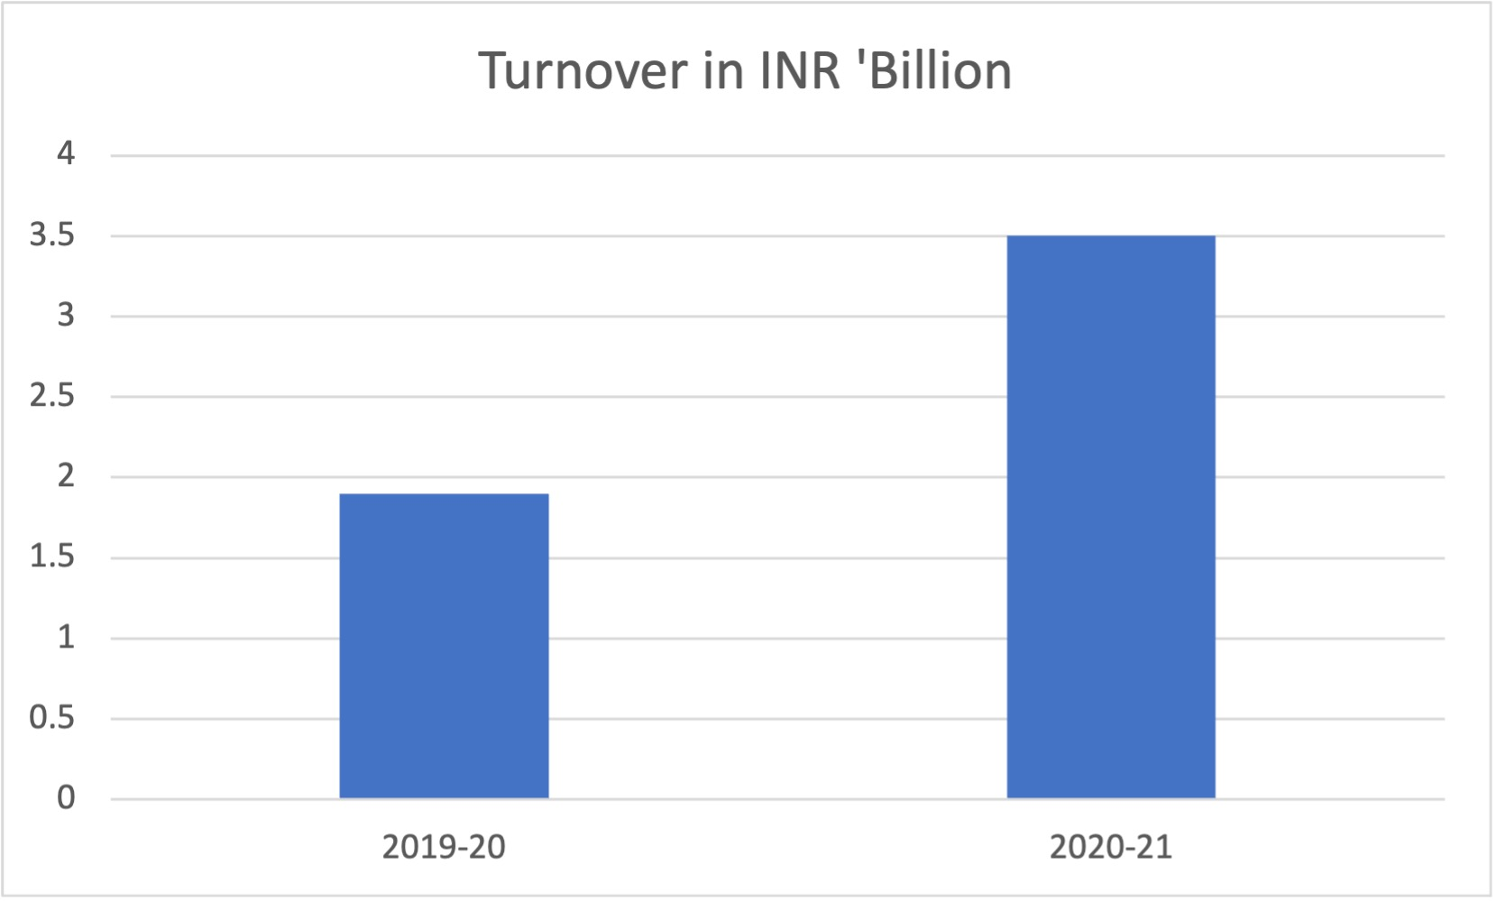
Some facts and figures of sales of Peanut Butter in Domestic market and Exports
Comparison of Year 2019-20 & 2020-21

Slide 8
I hereby Thank IOPEPC for giving this enormous opportunity to present regarding the Scenarios of Peanut Butter in Domestic Markets and Exports
-Vishal Ruparel (Ruparel Foods Private Limited)

